Slide 1
User Interface

Slide 2
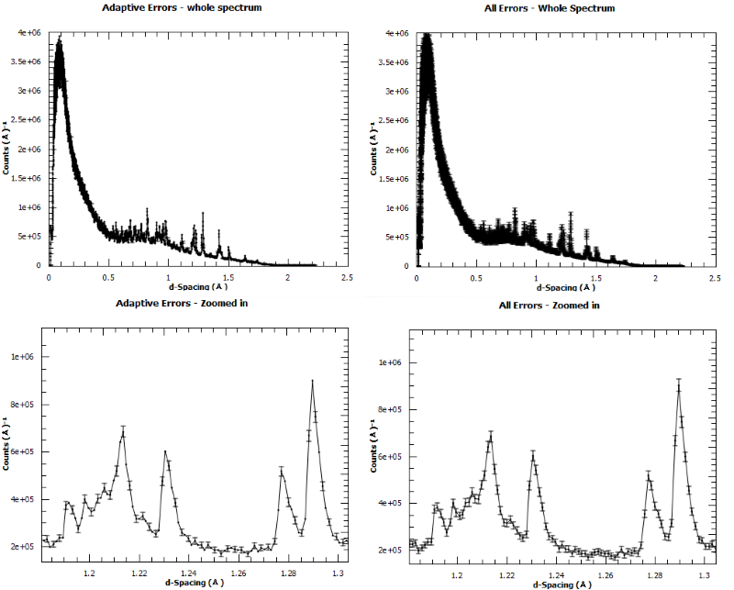
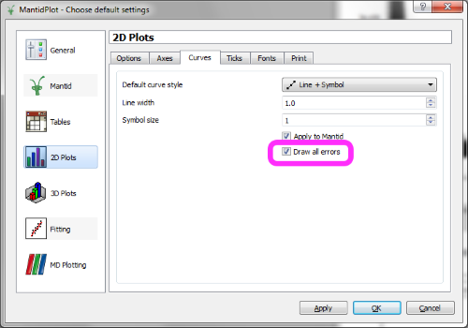
Line Plots
Graphs now show ALL error bars
Previously skipped some points based on the data density.
It can make dense data plots with errors look more obscured.
You can change it back by unselecting the option Draw All Errors in the View⇒Prefences menu

Slide 3
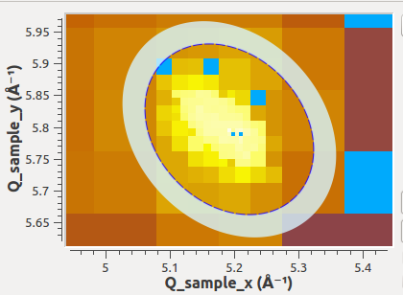
SliceViewer Improvements
The Matlab default colour map viridis has been added.
SliceViewer is now able to display ellipsoidal peak shapes.
The displayed ellipse is the result of the viewing plane cutting the peak ellipsoid.

Slide 4
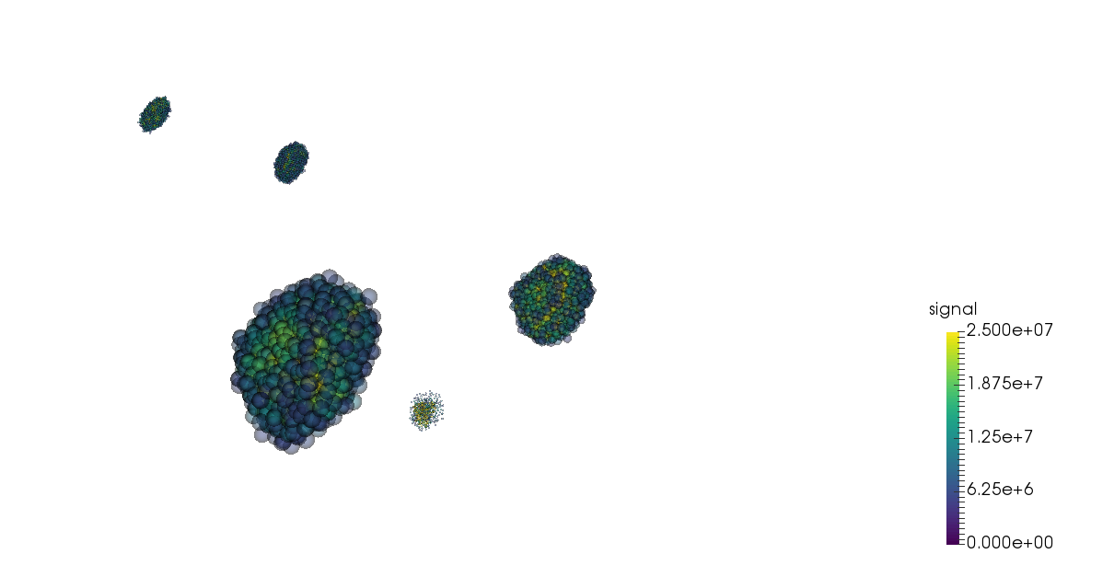
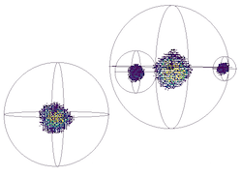
VSI Improvements
The splatter plot now uses translucent spheres to represent the neutron signal.
The sphere and ellipse wireframes have been simplified
easier to see the enclosed points.
Removed right-click option to view peaks workspaces
Drag peaks workspace into the VSI window

Slide 5
Others
Instrument View
Is now seperated from Mantidplot so it can be used in other interfaces, and direct from python.
Bugs resolved
Many bugs have been fixed, particularly in:
Plotting from Tables
Multidataset fitting
VSI

Slide 6
Documentation
Improvements for Nexus loading algorithms
Details the link between file structure and usage in Mantid.
The various calibration approaches have been documented in a single location under concepts.
The Bspline and Cubic spline are better documented, and have usage examples.
The various minimisers have been documented and evaluated against NIST standard problems.

